Slide 1

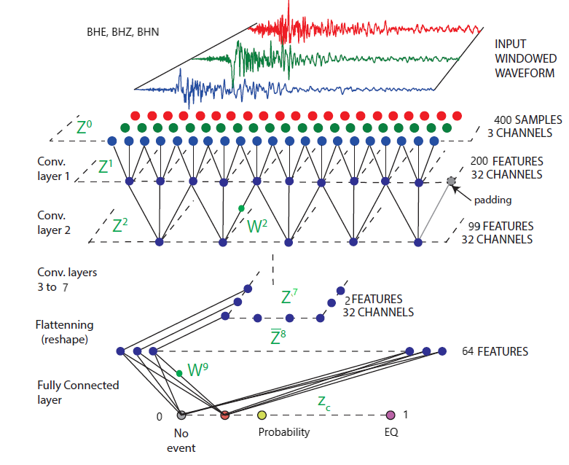
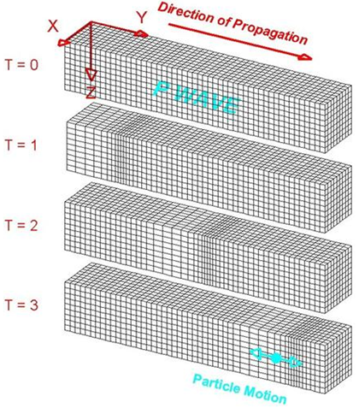
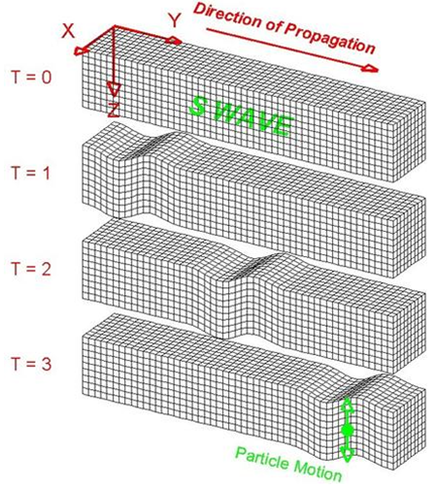
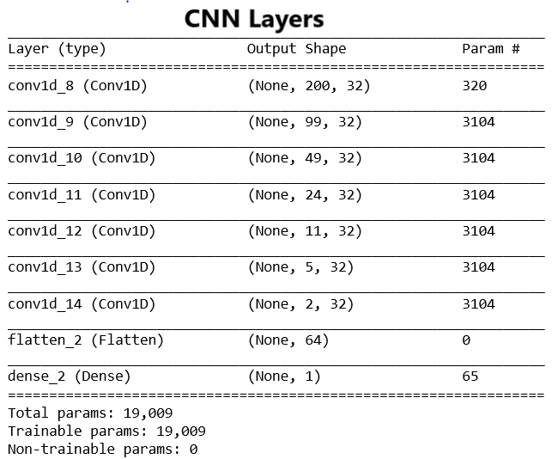
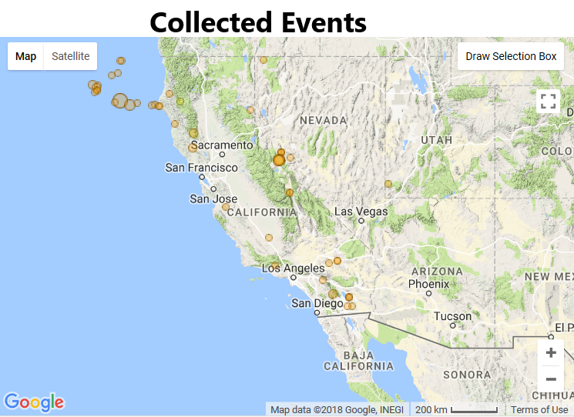
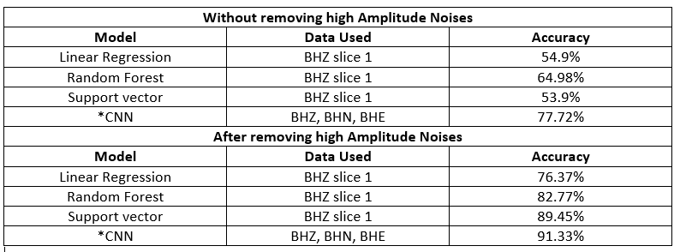
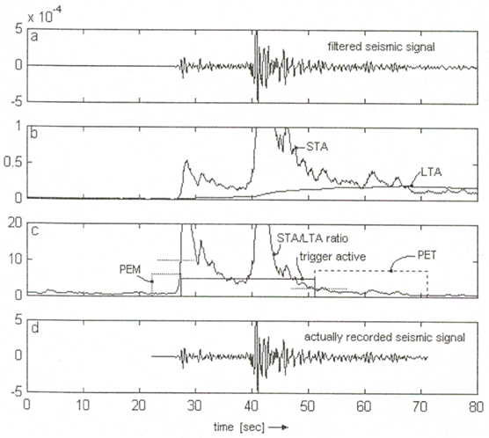
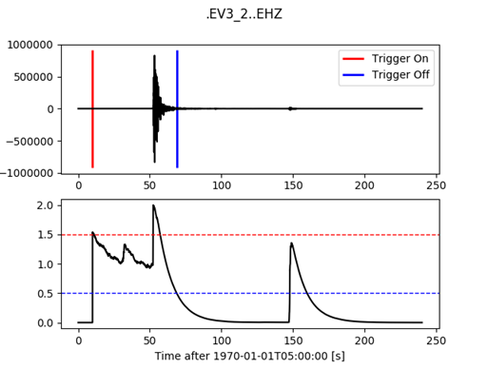
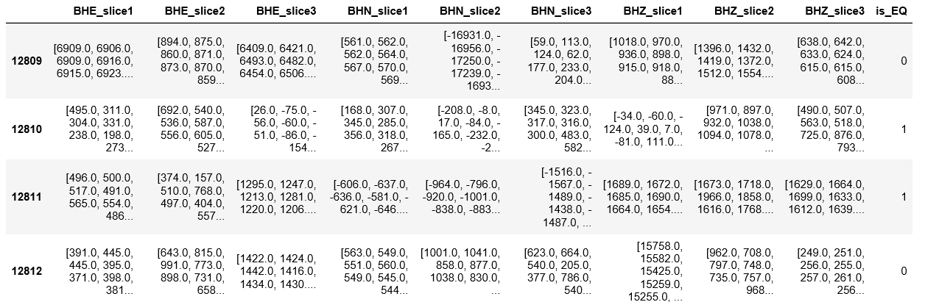
Electrical Engineering Department
Seismic data analysis and
classification based on Machine
Learning
Project Advisor: Dr. Birsen Sirkeci
Sandhu, Shaminderpal
(MS Electrical Engineering)
Saeidi, Ali
(MS Electrical Engineering)
Introduction
Methodology
Noise samples were extracted and scaled. The scaling coefficients of scaler were later used to eradicate high amplitude noises which left event to noise ratio at approximately 4806 to 4000. Resulting noise was compared with continuous noise samples.
Seismic events such as earthquakes are very under-researched in global scientific domains but, with advancements in Machine Learning, classification and analysis of seismic data is becoming more feasible. This project focuses on developing techniques to effectively classify Seismic data into earthquake events and seismic noise (mining blasts, man made noise etc.). The project not only focuses on developing deep learning models but, is also focused on collecting seismic data from credible repositories with proper labelling. An extensive research in seismology ensued proper knowledge of Earthquake waves, their propagation and behavior.
Data is collected around Southern California region with co-ordinates N = 44.83, W = -136.33, E = -110.05, S = 31.11. The data is collected from stations registered to networks AZ, BK, CI and NN. So, only those events were collected which were registered at these stations thus limiting distance by co-ordinates as well as network stations.
Data is collected for year 2016 which had 65 events registered at 75 stations with each station recording 3 channels BHZ, BHE and BHN. Four different time-series were collected from each station as:
P wave= 1 min before p to 1 min after p arrival.
S wave= 1 min before s to 1 min after s arrival.
Analysis and Results
Cleaned data was tried with number of 1D classifier with only one channel data. The performance measures were not as expected. In order to enhance accuracy, data from all 3 channels BHZ, BHN, BHE was used which required a classifier with 3-D input
Summary/Conclusions
The different approach for triggering and picking methods used in this project reduces dependency of research work on error prone algorithms. The effective collection of data and noise processing remains interesting research topics to pursue for future. The CNN network built for this project remains state of art and excels in performance metrics. The performance also partially depends on effective removal of high amplitude noises and can be further increased by reducing co-relation between events collected.
A custom 3-D classifier was built using Keras. The CNN has 7 convolution layers followed by 1 Dense layer. Convolution layers use RELU activation while Dense layer uses Sigmoid. Output of CNN is probability of a sample being earthquake or not. Probability close to 0 means no earthquake event and vice versa for earthquake.
Main motivation behind this project is to defy already accepted triggering(STA/LTA, Z Transform etc.) as well as Picking(AR picker, baer picker etc.) algorithms and formulate new techniques to extract P and S wave features. Problem with these algorithms is that different threshold values can produce entirely different triggers and accurate thresholds are hard to generalize for large number of events.
Noise= 5 min before event to 0 min after event.
Event= 1 min before event to 2 min after event.
Start time of P wave and S wave samples is sufficient to extract P and S arrival times while Event represents when event triggers (happens at epicenter).
Data Processing and Challenges
Collected data is processed, filtered and converted to ML friendly format. Each event SAC file is cut into 3 slices of 10 seconds starting from event occurrence(trigger). Assumption is, that longest event does not last more than 30 seconds. As data is sampled at 40Hz, each window is of length 400 samples. The Noise is processed similarly with only exception being number of slices which are 5, i.e. 50 seconds. Processed data is saved as JSON file containing all event and noise samples. It includes binary pointer which is 0 in case of Noise sample and 1 in case of Earthquake sample.
Initial tests of processed data with simple ML models showed very bad performance. Which, was later found out to be due to presence of high amplitude noises being classified as Earthquake events by ML algorithms. The standard scaling techniques were slightly modified to get rid of rogue noises. The initial processed data had Event to Noise ratio of 4806:8008.
[1] “Understanding and parameter setting of STA/LTA trigger algorithm” Amadej Trnkoczy (formerly Kinemetrics SA), September, 1999.
[2] “Seismic waveform data retrieval”, Joachim Saul, GFZ German Research Centre for Geosciences, December 2014, DOI: 10.2312/GFZ. NMSOP-2_IS_8.3.
[3] “Convolutional Neural Network for Earthquake
Detection and Location”, Thibaut Perola, Michael Gharbib, Marine A. Denollec, 7 Feb 2017
[4] “Hundreds of earthquakes per day: The 2014 Guthrie”, M. Benz, N. D. McMahon, R. C. Aster, D. E. McNamara, D. B. Harris, Oklahoma, earthquake sequence, Seismological Research Letters 86 (2015) 1318{1325.
Key References
Input to CNN is 3-D tensor made up of of BHZ, BHE and BHN channel data. Data was reshaped and stacked to give parallel channel input to CNN. CNN calculates 1-D convolution of each channel and process data in parallel for 3 channels.
The CNN use Early Stopping criteria to avoid overfitting and saves model weights to be used for predictions or handling different data in future. Train to test data ratio was 75:25 so 6604 samples were used for training and 2202 samples for testing performance.
Methodology
Motivation and Data Collection
STA/LTA algorithms involved in majority of past works are not very reliable for Machine Learning models as slight change in threshold can change classification. So, to pick up P wave and S wave arrival times data collection techniques were modified.
Val_precision | Val_recall | Val_fmeasure | Val_accuracy
CNN Performance before removing high amplitude noises
0.7285 | 0.6287 | 0.6616 |  | 0.7772
CNN Performance after removing high amplitude noises
0.9651 | 0.8715 | 0.9129 |  | 0.9133
After removing high amplitude noises from data, using absolute values of samples further increases the efficiency of CNN
As problem posed is binary classification in nature, it is suitable to use multiple performance metrics. It also gives better understanding of CNN’s working as model is probabilistic in nature. We used four different metrics: Binary accuracy, Precision, Recall and F measure, with latter 3 being custom built for CNN model. CNN shows high performance in all metrics
Acknowledgements
This project would have never been possible without valuable guidance and advices of Dr. Birsen Sirkeci. We would also like to thank IRIS’s Data services for permission to collect data and replying to our queries in timely manner. We would like to extend our gratitude to our counterpart Team in computer science department of SJSU and Dr. Yezu Gao for answering our queries and providing data for cross-validation.
This project relies on credible repository of IRIS DMC and uses IRIS’s Wilber3 tool to collect data. The samples collected are in SAC format and contain additional information in headers which can be used as extra features for classification models.

